Slide 1
Self- care strengthening
Learning Outcome 7

Slide 2
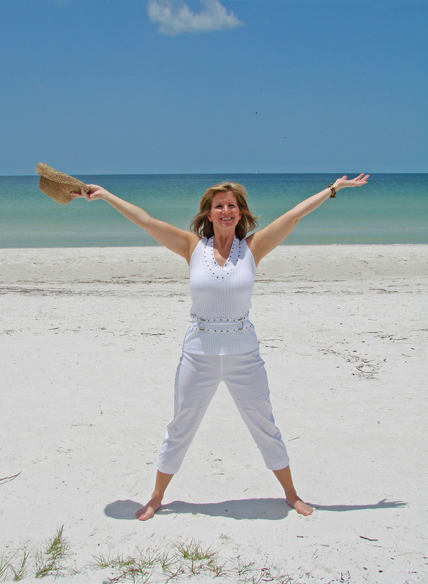
What Makes People Healthy?

Slide 3
Social Determinants Of Health
2002 York university outlined
14 indicators or determinants
of health.
http://digg.com/video/george-takei-animation-life-expectancu
Each of these have a large impact on the health of Canadians
Raphael, D. (2009). Social Determinants of Health: Canadian Perspective

Slide 4
Social Determinants of Health
Income and income distribution
Education
Unemployment
Employment/Working Conditions
Early childhood development
Food Insecurity
Housing.
Social Exclusion
Social Safety
Health Services
Aboriginal Status
Gender
Race
Disability

Slide 5
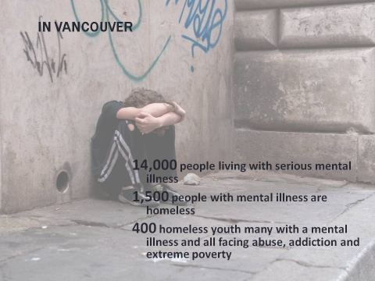
Social Determinants Impact on Mental health

Slide 6
Affects on Mental Health
  Reflection
  Identify 2 social determinants that have effected your mental health positively
  Identify 2 social determinants that have effected your mental health negatively

Slide 7
A healthy community
How would you design a healthy Saskatchewan Polytechnic community
-Using the social determinants of health -how might you increase the health of this community-

Slide 8
STRESS
“At the physiological level chronic stress can lead to prolonged biological reactions that strain the physical body”
“At the psychological level, stressful and poor living
conditions can cause continuing feelings of shame,
insecurity and worthlessness”
http://www.thecanadianfacts.org/The_Canadian_Facts.pdf

Slide 9
Stressors
Stimuli that are challenging, threatening, or demanding to individual
Requires increased energy
Produces tension and stress
May begin in the internal or external environment
Timing, duration, number, frequency of stressors significant

Slide 10
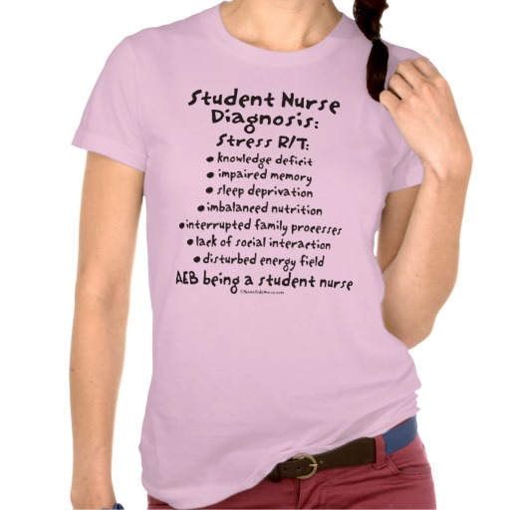
Stressors

Slide 11
Stressful Life Event Categories
Family
Work
Education
Social life
Health
Financial or legal crisis
A person coming into or leaving your life
A favorable social event: promotion, engagement, marriage
An unfavorable event - death, divorce

Slide 12
Life Strain and Stressors
Chronic conditions related to family tension, job problems, loneliness
  Marital/partner strife
  Parenting challenges
  Financial issues
  Work role /overload
Small, daily hassles or strains may affect moods and health more than major misfortunes do

Slide 13
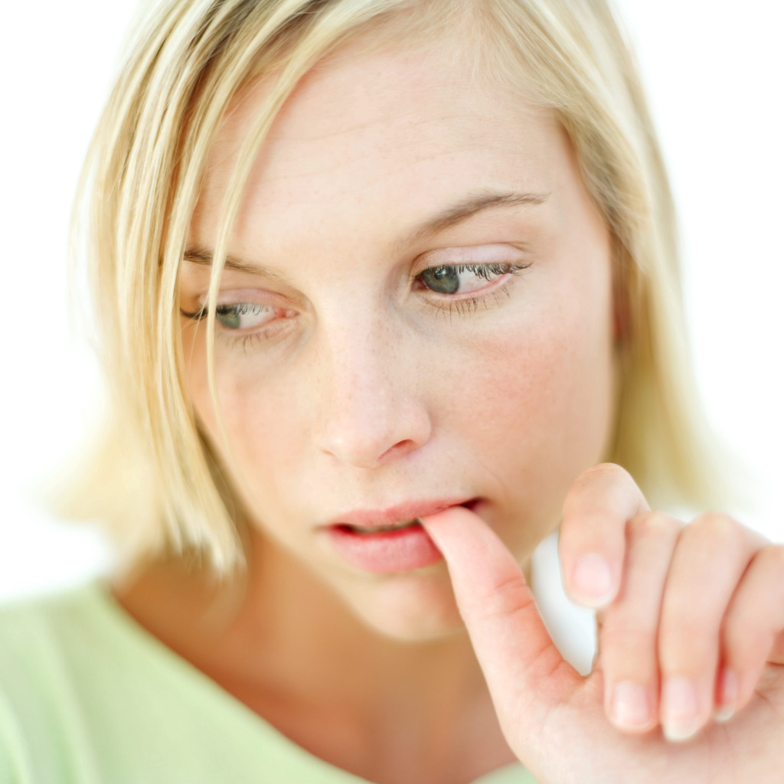
Appraisal of Stressors
What is the appraisal of the stressor?

Slide 14
Stress Response
  Physiological Response
    Fight-flight or freeze
    Affects immune system - decreasing ability to fight disease
  Cognitive response
    evaluate potential damage or harm and available resources
    brain response- interaction of several hormones and transmitters including: growth hormone, prolactin thyroid-stimulating hormones, oxytocin, insulin, epinephrine

Slide 15
Stress Response
Emotional response
  an arousal of a feeling -usually nonspecific or generalized anxiety reaction.
Social response
  searching for meaning
  identifying contributing factors, comparing with others with similar problems
  evaluating need for support

Slide 16
Coping Resources
Options or strategies for determining what can be done?
    Economic assets, abilities, skills
    Social skills
    Social and spiritual supports
    Motivation and positive beliefs
    Health and energy
    Problem-solving
    Material resources
    Relationships with individual, family, group, society

Slide 17
Coping Mechanisms
Efforts directed at stress management
  Problem focused (coping with threat itself)
    confrontation, seeking advice
  Cognitively focused (control meaning)
    positive comparison, selective ignorance, devaluation of desired objects, reframing
  Emotion focused (ego defense mechanisms)
    denial, projection

Slide 18
Coping Mechanisms
Positive
  Anxiety treated as warning signal
  Individual accepts it as challenge to resolve problem
  Uses past experiences to meet future threats
Destructive
  Anxiety not recognized
  Conflict not resolved
  Runs away instead of resolving
(Stuart, G., Psychiatric Nursing, 9th ed. 2009)

Slide 19
Biological factors and stress
Genetic background
Nutritional status
Biological sensitivities
General health

Slide 20
Psychological factors and stress
Intelligence
Verbal skills
Morale
Personality
Past experiences
Self-concept
Motivation
Psychological defenses
Locus of control (sense of control over fate)

Slide 21
Sociocultural factors and stress
Income
Occupation
Social position
Cultural background
Religious beliefs
Political beliefs
Level social connection

Slide 22
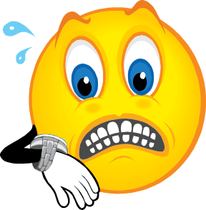
Stress Reduction Kit
Bang
Head
Here
Directions:
Place kit on a firm surface.
Follow directions in circle of kit.
Repeat step 2 as necessary, or until unconscious.
If unconscious, cease stress reduction activity

Slide 23
Self Efficacy
Personal Capacity
our belief in our ability to succeed in specific situations. Your sense of self-efficacy can play a major role in how you approach goals, tasks, and challenges.
https://www.youtube.com/watch?v=QyhhXuWHQLM
https://www.youtube.com/watch?v=LB7eC0f1TXU
Notes:
self-efficacy.

Slide 24
Self Efficacy
Strong sense of self efficacy
Weak sense of self efficacy
View challenges as tasks to master
Develop greater interest for activities they participate in.
Strong commitment to their activities and interests
Recover quickly from set backs and disappointments
Avoid challenging tasks
Believe difficult tasks and activities are beyond their capabilities.
Focus on personal failings and negative outcomes
Lose confidence in their abilities
Bandura, A. (1995)

Slide 25
Steps to develop self efficacy
Take One Small Step at A Time -
Draw from successes in your past
Visualize success
Find a role model and support
Accept that self doubt happens- but limit the energy you give to it
Be happy
Seek social support

Slide 26
Resiliency
Resilience is an individual's ability to adapt well and recover quickly after enduring stressful, life-changing situations.

Slide 27
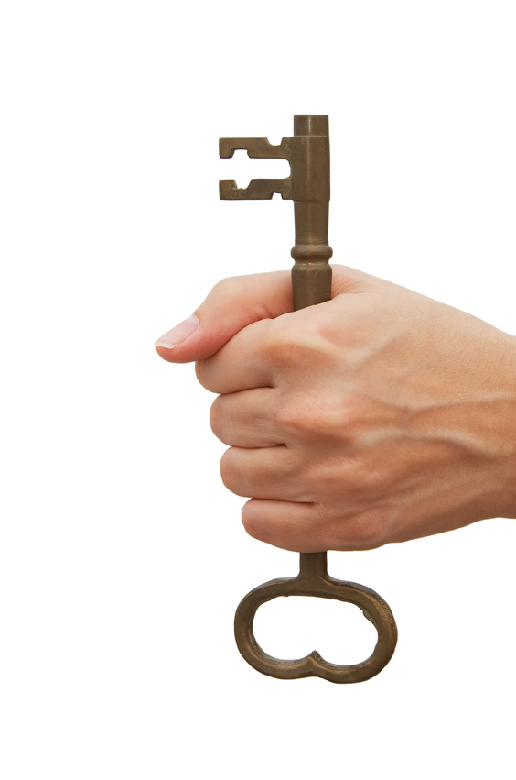
Three Key Resiliency Features
Attitude
  a consistent choice of optimism
Do you have hopeful expectations
for positive results?
Do you realistically look for the best possible
outcome in each situation?
(D. Johnston, 2010 )

Slide 28
Three Key Resiliency Features
Practicing stress reduction
Do you set limits and say no to those extra demands?
Do you take time to unwind from stress
i.e. physical exercise, meditation, yoga?

Slide 29
Three Key Resiliency Features
Participating
  a consistent choice to fully participate in life.
Do you have a sense and seek
purpose and joy?
Do you appreciate and practice gratitude
for the simple joys of life?

Slide 30
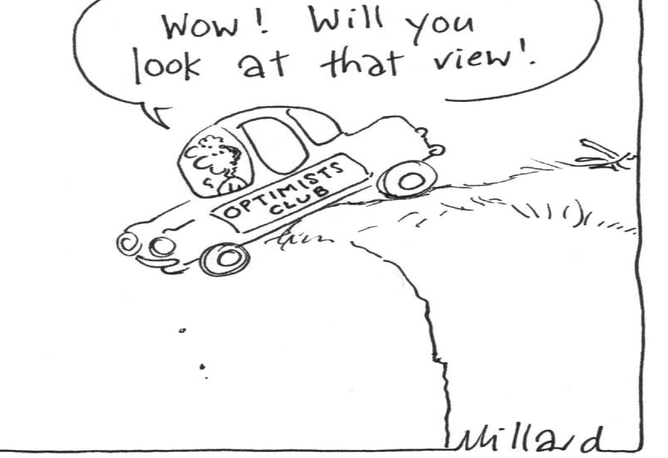

Slide 31
Resilience
Cultivating resilience
https://www.youtube.com/watch?v=eLzVJVM1BUc
Fall down 7 times----get up 8
https://www.youtube.com/watch?v=1osUTlLNGFI

